Slide 1
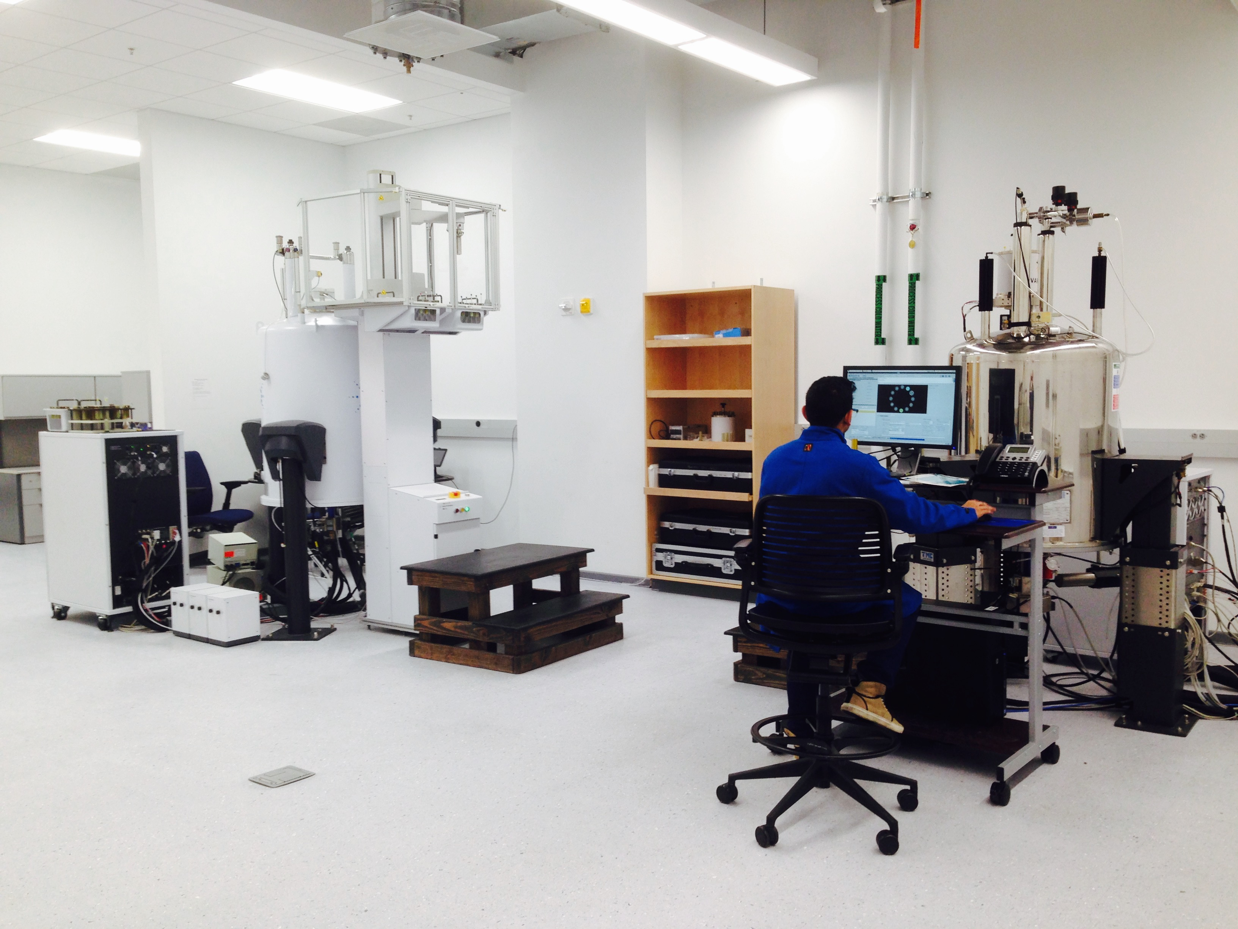
School of Natural Sciences NMR Facility
Introduction to the NMR Facility
Information
NMR Facility Introduction

Slide 2
The NMR Instruments
Agilent Technologies 400 MHz – “MR400 DD2” – Science and Engineering 2, Room 20 – Back of the Room
Agilent Technologies 500 MHz – “Propulse” – Science and Engineering 2, Room 20 – Front of the Room
Bruker Inc. 600 MHz – “Avance III” – Castle Building 1201 in Atwater – Room 1201
Information
NMR Facility Introduction

Slide 3
The Available NMR Experiments
Agilent 400 MHz
Two channels, ¹⁹F-¹H/¹⁵N-³¹P, Agilent OneNMRTM probe, 12-sample Automation - for Organic Solutions, with walk-up use. Typical experiments are ¹H, ¹⁹F,¹³C and ²H 1-D along with 2D ¹H COSY, ¹H-¹³C HSQC, HMBC etc. A single sample run is limited to 30 minutes during the day. Multi-hour use is permitted after 6:00 pm.
Agilent 500 MHz
Two channels, ¹⁵N-³¹P/¹⁹F-¹H, Agilent OneNMRTM probe, 96-sample Automation - for Organic Solutions and Special Experiments, with walk-up and reserved use. The 500 provides walkup backup for the 400 during the day as well as special experiments. One may reserve for long runs.
Bruker 600 MHz
Four channels ¹H/¹³C/¹⁵N/²H, Bruker CryoProbe – For Biomolecular and Protein Experiments, with reserved use only. Several groups use the 600 for multi-dimensional protein NMR where runs may last several days to a week. The 600 is available by arrangement for other experiments when it is needed.
Information
NMR Facility Introduction

Slide 4
Access to the NMR Facility and Data
Your Cat Card Should Open the Lab Door (SE2-20)
For Chemistry and the SNS, see your faculty advisor for access. For other schools the NMR facility can get the access directly. The lab is available 24 hours. It has wireless but poor or no cellphone service. Use good judgment after hours.
Log into the 400 or 500 with an Operator Name.
Log into the NMR software with your assigned operator name (a lowercase derivative of your first name). The operator name is tied to your faculty group name and his used to monitor usage and archive data. Always log out when finished and never use the wrong operator. If your operator is not on the login page, ask to have it assigned. This checkout allows you to use either the 400 or the 500 in SE2-20.
Raw Data is Archived by Operator and Faculty Group
Find your raw data in /home/UCM400/data/ (400) and /home/UCM500/data/ (500) under facultygroup/operatorname. Both of these directories can also be found in the server directory, available from the desktop of either instrument. Ask about data transfer and off line processing.
A PDF Plot of your Spectrum will be Emailed
You will get a PDF plot of each spectrum at the email address you supply. Ask if the address needs to be changed or removed.
Information
NMR Facility Introduction

Slide 5
The 400 and 500 are Highly Automated!
Queue multiple samples with the 12-sample and 96-sample robots.
Select your experiment (1-D or 2-D) from the “Study Queue”
Automatic probe tuning for nuclei other than protons
Automatic ²H lock and gradient shimming
Automatic data archiving – get the result by email.
The automation of the 400 and 500 allows you to do many advanced experiments safely with only a small amount of experience. However, you are encouraged to learn more to customize experiments and recognize problems. Ask for help!
Information
NMR Facility Introduction

Slide 6
Some Safety Issues
Beware of stray magnetic fields
A. The “Sample Bore” > 100,000 Gauss – very high!
B. Upper (Lower) Bore: about 10 to100 Gauss. This region may grab steel tools, magnetize your analog watch, wipe credit cards and possibly affect your cell phone.
C. Caution Zone: about 5 Gauss – accepted as safe but don’t risk the above items of B.
D. Safe Zone: about 1 Gauss – close to the earths background field.
B
Bore
D
C
Dewar
A
Float
Magnet
Leg
B
Information
NMR Facility Introduction

Slide 7
Some Safety Issues
Protect Your Health
Magnetic fields can affect metal implants in the body and can cause the malfunction of electronic health aids such as pacemakers! If you have either, do not enter the NMR Lab without letting us know!
Read the caution signs on the lab door.
Otherwise (even high) magnetic fields are thought to be safe for a healthy person, certainly zones B to D.
B
Bore
D
C
Dewar
A
Magnet
Leg
B
Information
NMR Facility Introduction

Slide 8
Some Safety Issues
Be Aware of Cryogenic Gases!
The magnet sits in a bath of liquid helium at 4.2 Kelvin and the helium bath is surrounded by a jacket of liquid nitrogen at 77 Kelvin. We refill the nitrogen every week and the helium about every 3 months. Partially filled Dewars are often present in the lab.
An NMR Magnet can “Quench”
A sudden loss of field (hopefully unlikely) can cause rapid outgassing of the helium and nitrogen. If you see cold vapor above the magnet evacuate the NMR lab to avoid any possibility of injury.
Cryogenic Gasses Cause Severe Burns
.. and the excess helium and nitrogen in the air will force depletion of oxygen and one could become light-headed. Be aware though, depletion is not a serious concern with the size of our lab.
Liq N₂
70K
Liq He
4.2K
Magnet
Information
NMR Facility Introduction

Slide 9
Some Safety Issues
Set the Sample Depth Correctly
Use the depth gauge to set the sample in the spinner. A tube that is too long below the spinner can damage the probe.
Be careful – don’t break the tube during its insertion into the spinner.
Never drop a spinner directly in the bore without air. It can land hard and damage the probe.
Don’t Lean on the Magnet Legs
The magnet floats on its legs to dampen room vibration. The magnet can tilt if you lean against it. Loss of floatation can cause vibrational sidebands (baseline fuzz) in the spectrum.
Bore
Tube
Spinner
Float
damage?
Leg
Probe
Information
NMR Facility Introduction

Slide 10
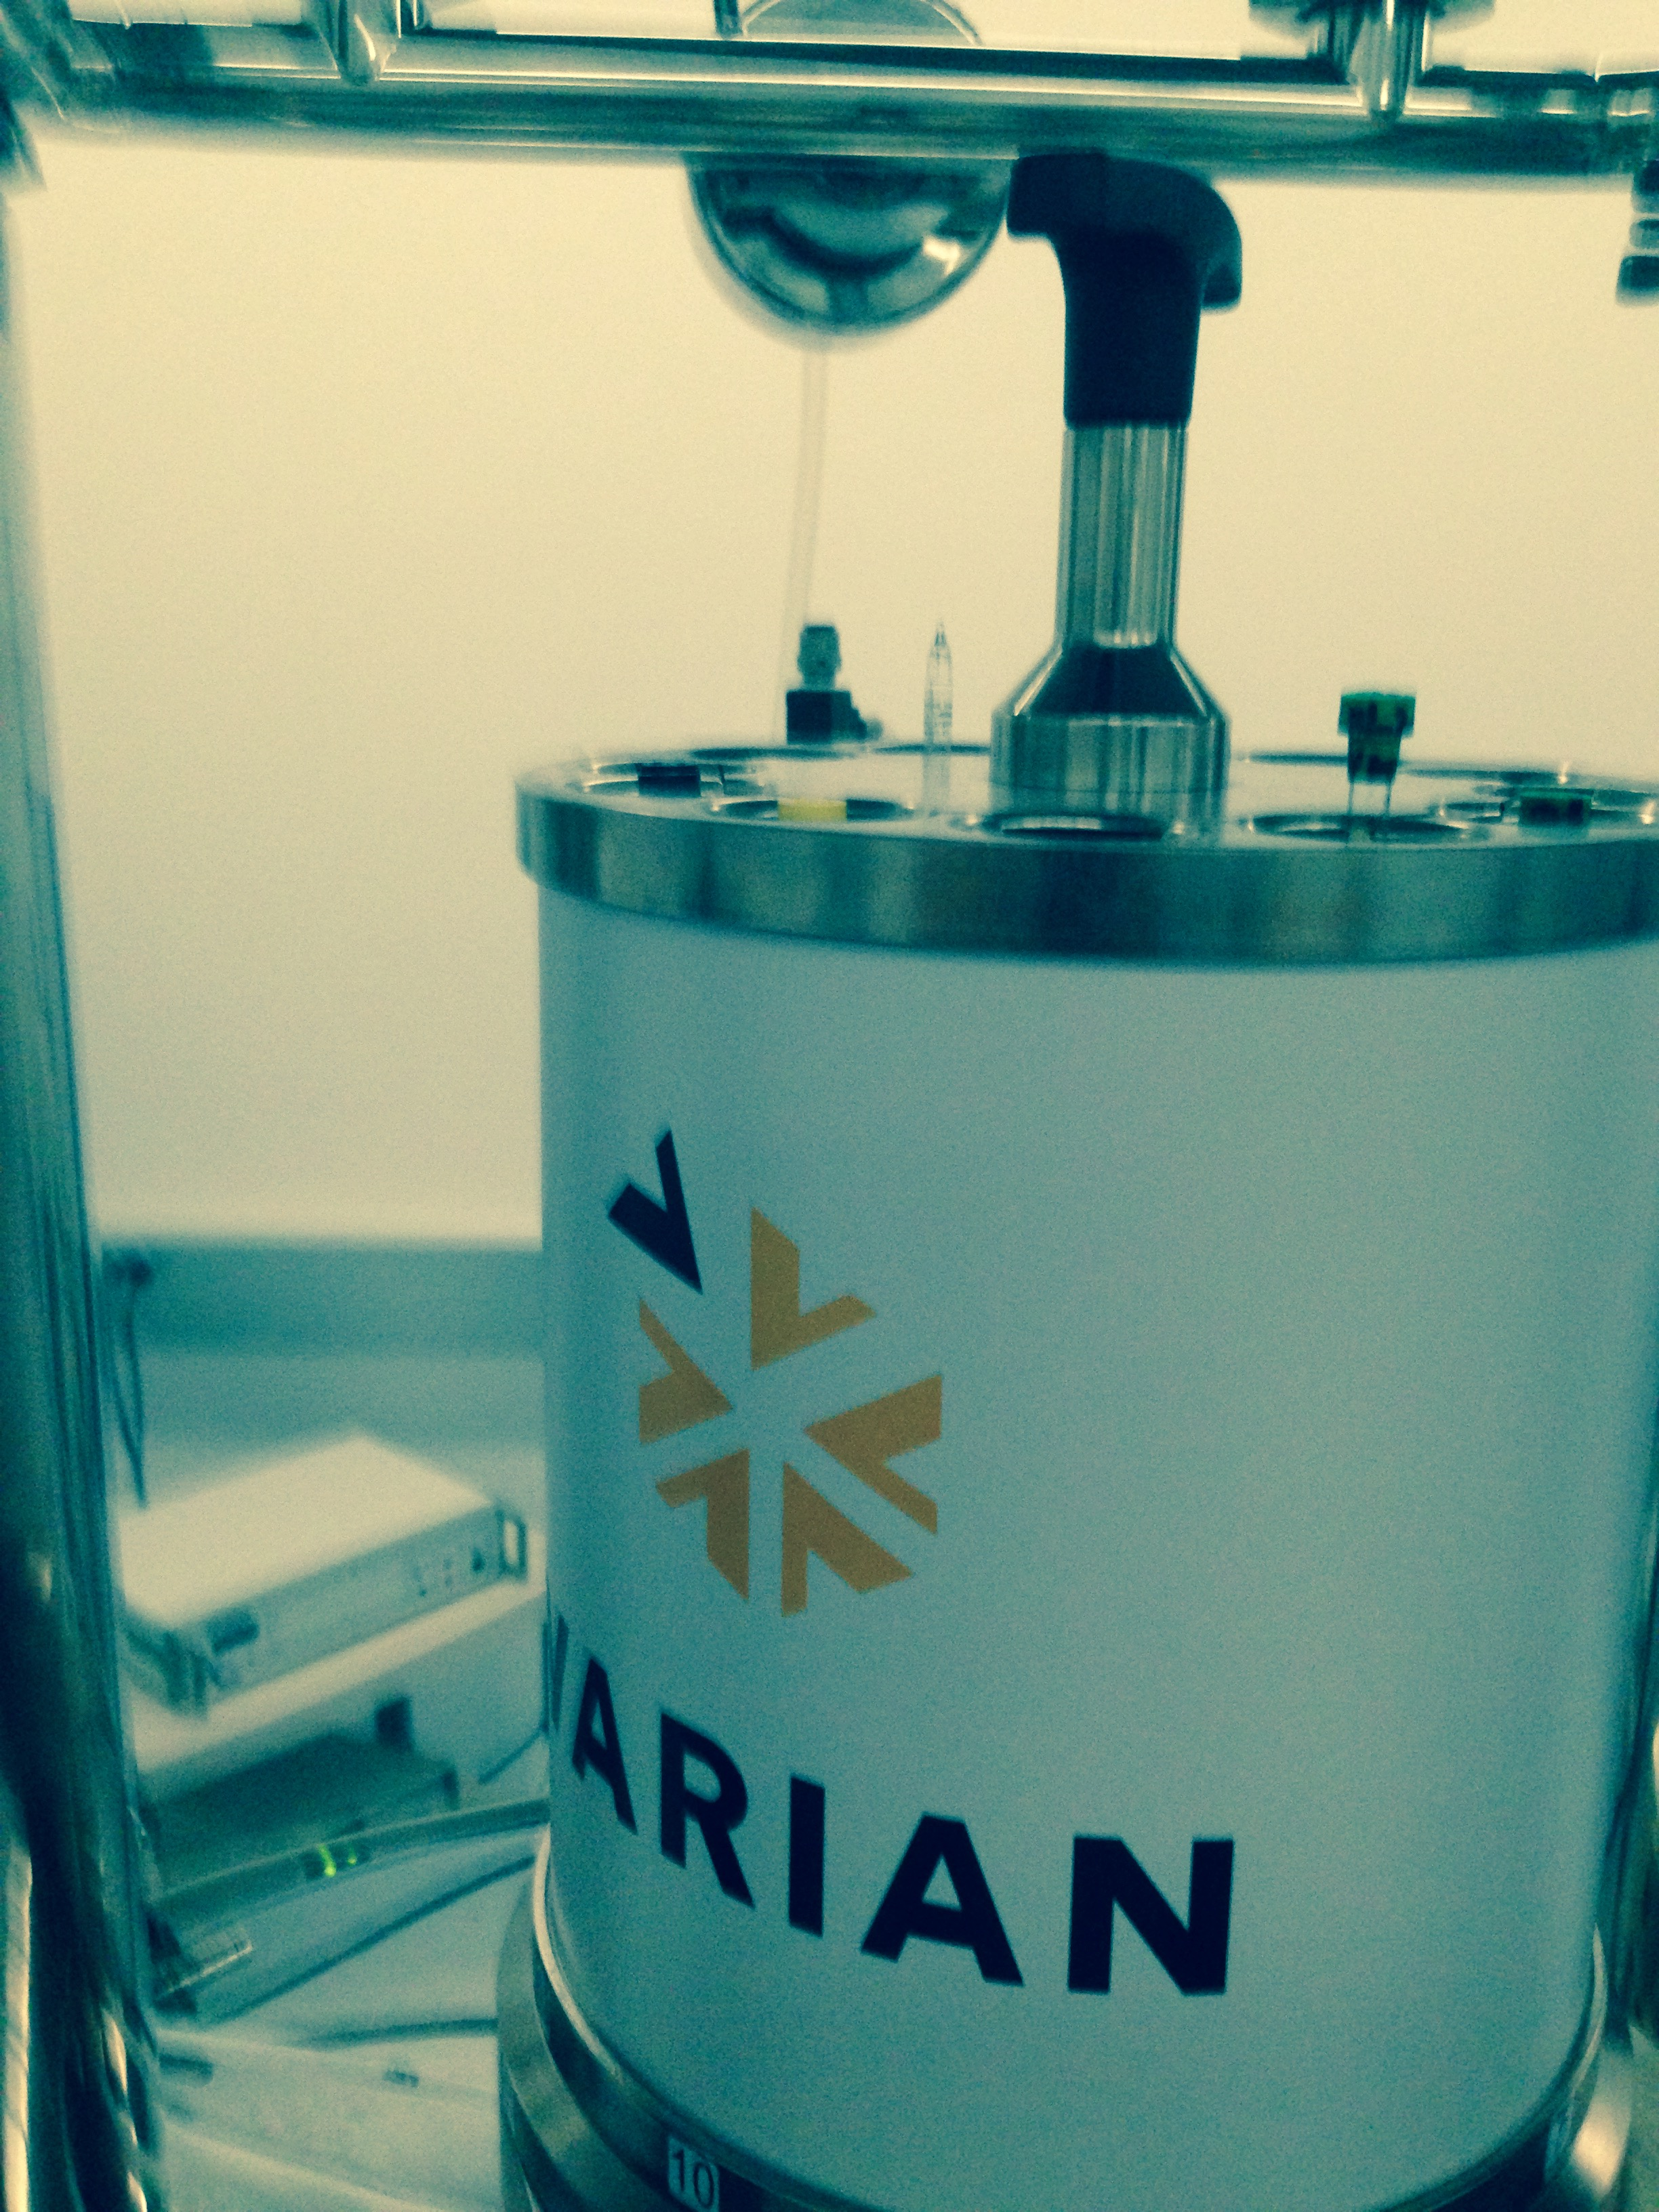
Auto Sample Insertion – MR400 DD2
MR400 Sample Insertion is Automatic
The MR400 contains a 12-sample carousel to insert samples automatically. Place your sample in one of the 12 numbered locations of the carousel. You will specify the location when you start the experiment.
The Carousel Rotates to the Bore and Drops the Sample
The carousel rotates to a position over the bore and drops the sample on a cushion of air. The tube below the red arrow (location 2) is sitting over the bore in this picture. The tube below the green arrow is in location 8.
Information
NMR Facility Introduction

